Slide 1
CHEMICAL TECHNOLOGY

Slide 2
DISTILLATION
The process in which components from liquid mixture are separated heating and condensation is called distillation.
Types of distillation:
Simple distillation
Fractional distillation
Vacuum distillation
Steam distillation

Slide 3
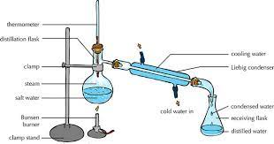
Simple Distillation:
It is carried out
1. to purify liquids containing non-volatile impurities, provided the liquid does not decompose at its boiling point.
2. For separation of mixture of liquids which differ in their boiling points at least by 20 – 30⁰C.

Slide 4
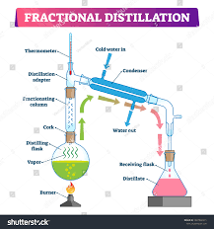
Fractional Distillation:
It is employed if organic liquid to be purified contains liquid impurities . The components are separated based on the difference in their boiling points and vapour pressures.

Slide 5
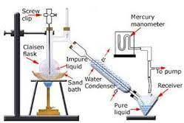
Vacuum distillation:
It is employed for the purification of liquids that decompose at their boiling points.

Slide 6
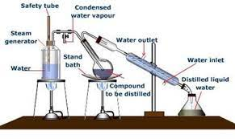
Steam Distillation:
It is used to purify liquids which are immiscible with water and steam, i.e. the volatile water insoluble organic solids which can ne easily carried in a current of steam.

Slide 7
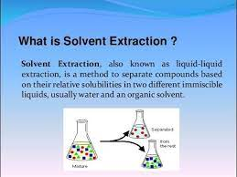
Solvent Extraction:

Slide 8
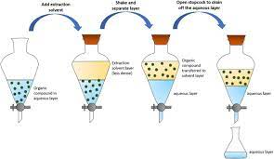
Overview of Solvent Extraction:

Slide 9
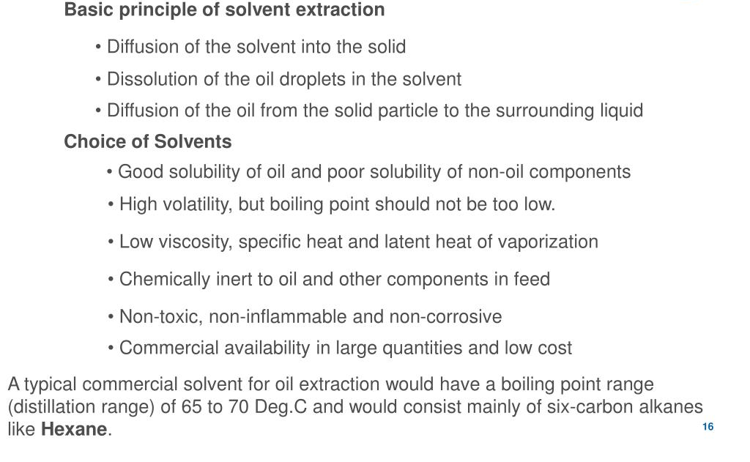

Slide 10
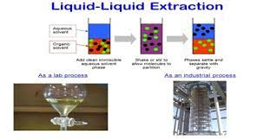

Slide 11
Methods of Extraction:
Batch operation: The method involves shaking the aqueous layer containing the solute with an immiscible solvent in a separating funnel and system is allowed to attain the equilibrium by keeping it undisturbed for some time.Complexing agent is added to extract the solute form aqueous phase into organic layer. The two solvent layers are separated by opening the stop cock and withdrawing the required layer.
Stripping: Removal of extracted solute from the organic layer.
Estimation: Estimation of amount of solute separated is determined by spectrophotometry, polarography, potentiometry etc.

Slide 12
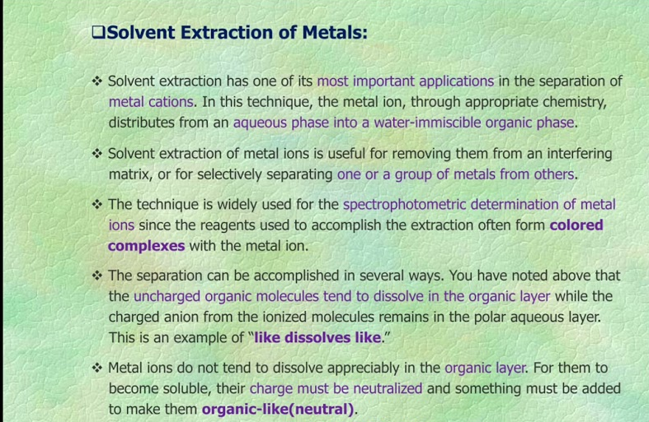
Application of solvent extraction:

Slide 13
Chelating agents used in solvent extraction:
The charge neutralization of metals is carried out by the formation of metal chelates. The resulting metal-chelate complex is bulkier and hydrophobic in nature and is soluble in organic layer. They are coloured and can be determined by spectrophotometry.
Chelates of different metals can be extracted at different pH.

Slide 14
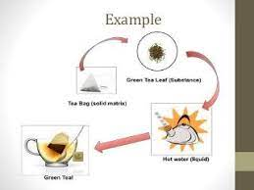
Solid- Liquid Leaching:
This process is used to separate the desired solute component or to remove an undesired component from the solid phase.

Slide 15
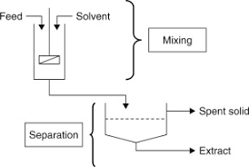
Overview of Solid Liquid Leaching:

Slide 16
Solids and solvents for leaching:
The preparation of solids for leaching is carried out as follows:
1. The plants products such as beet root, sugar beet can be cut into slices for leaching,
2. The oil seeds are ruptured by rolling and flaking so that the vegetable oil can be easily leached by the solvent.
3. For the pharmaceutical preparation, the leaves, stems and roots are dried before extraction.
The leaching solvent:
1. Should not dissolve the solute free solid residue.
2. Should be present in sufficient amount for complete leaching of the solute.

Slide 17
Thank You

